Slide 1


Yes, YOU can simulate!
Reproducible, Tidy Workflows with the Reimagined simpr Package
Ethan C. Brown, PhD
useR! 2024, Salzburg
https://openclipart.org/detail/280519/strange-meeting
This Photo by Unknown Author is licensed under CC BY
Notes:
Question: wh

Slide 2
The case for simpr
Do you want to understand the models you’re using?
Are you planning a study, doing a power analysis, or trying to evaluate a statistical method?
Do you know that simulation can help but you’re overwhelmed by the complexity of creating a simulation?
statisfactions.github.com/simpr

Slide 3
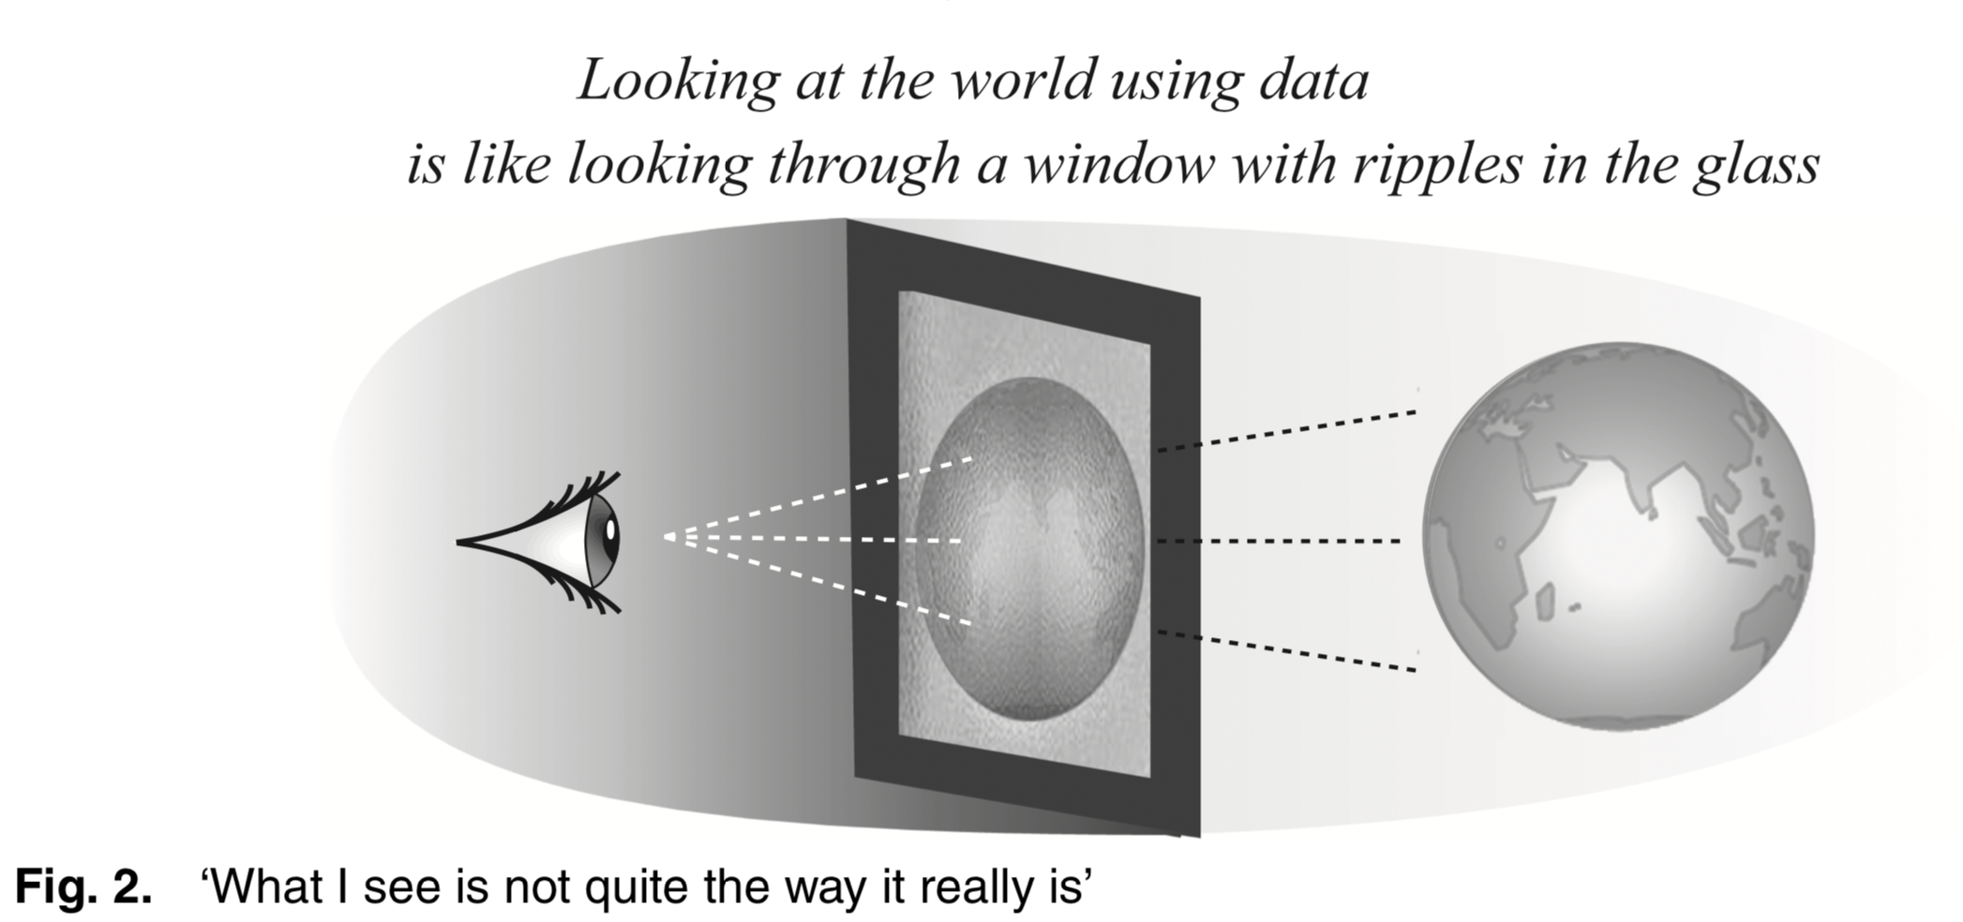
Understanding Your Models
[clipart:]
statisfactions.github.com/simpr
Wild et al. (2011)
Notes:
If we don’t understand the lens we are looking through, we don’t understand what we see in that lens. Give credit here to both anti-racism work and to Buddhism for these analogies

Slide 4
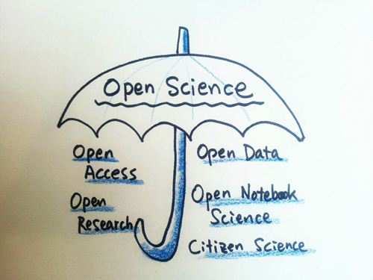
Open Science and “What Ifs”
This Photo by Unknown Author is licensed under CC BY
Will this design answer our research questions?
vs
Under what conditions will this design answer our research questions?
Transparently show the boundaries and assumptions of the design
Support writing of preregistrations, prospectuses, and registered reports by a disciplined examination of possibilities
Look at the ranges of possible quality (power, bias) based on what we assume is true about reality
statisfactions.github.com/simpr

Slide 5

SIMULATION-BASED DESIGN ANALYSIS
Model the data-generating process, including sampling, assignment, measurement
Generate simulated data based on the data-generating process
Fit the proposed model and evaluate whatever outcomes we’re interested in (power, bias, convergence…).
This Photo by Unknown Author is licensed under CC BY-NC-ND

Slide 6
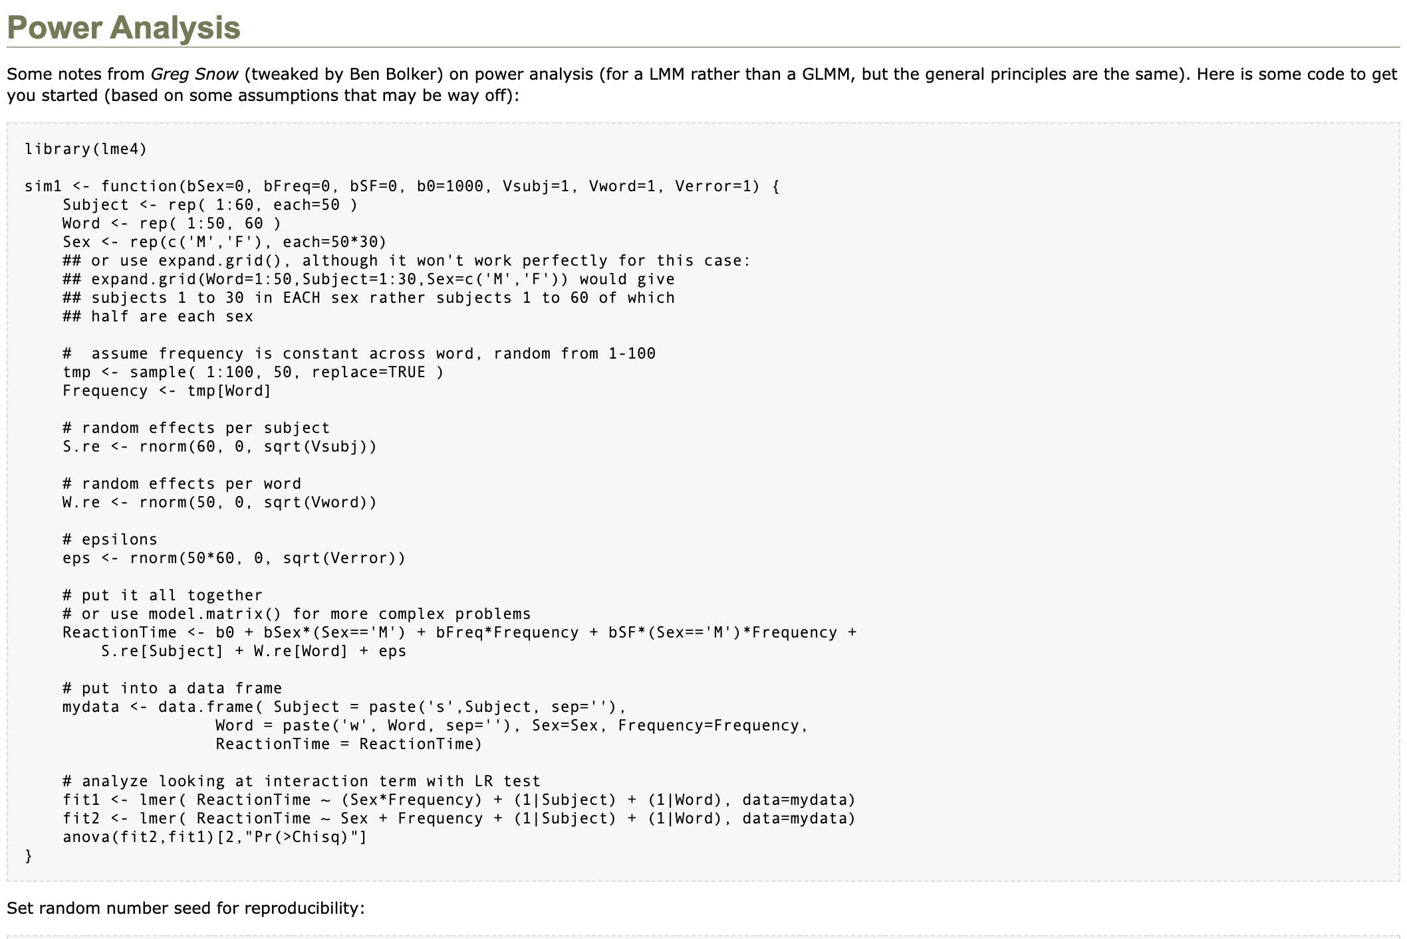

Is this your feeling when doing a simulation?
Source: http://glmm.wikidot.com/power-analysis
This Photo by Unknown Author is licensed under CC BY
statisfactions.github.com/simpr

Slide 7
Challenges of simulation
Require understanding underlying statistical model
Simulations make just as many assumptions as analytical methods, and may not be reasonable
Custom simulations often difficult to code
Simulations easy to mislead by missing fundamental features of the process
statisfactions.github.com/simpr

Slide 8
Is 100 students enough?
Study: Pre-post comparison of the “Triglicious” intervention
Research question: Did Triglicious improve students’ math scores?
Method: Paired t-test
Pretest
Intervention
Posttest
statisfactions.github.com/simpr

Slide 9
Simulations in base R
## Set up parameters ns = c(100, 150, 200) mean_diffs = c(10, 20, 30) sds = c(50, 100) reps = 10
statisfactions.github.com/simpr

Slide 10
Simulations in base R
## Set up parameters ns = c(100, 150, 200) mean_diffs = c(10, 20, 30) sds = c(50, 100) reps = 10 ## Bring together into data frame results_template = expand.grid(n = ns, mean_diff = mean_diffs, sd = sds, p.value = NA_real_) base_r_sim = results_template[rep(1:nrow(results_template), each = reps),]
statisfactions.github.com/simpr

Slide 11
Simulations in base R
## Set up parameters ns = c(100, 150, 200) mean_diffs = c(10, 20, 30) sds = c(50, 100) reps = 10 ## Bring together into data frame results_template = expand.grid(n = ns, mean_diff = mean_diffs, sd = sds, p.value = NA_real_) base_r_sim = results_template[rep(1:nrow(results_template), each = reps),]
## Loop over rows of the data frame and calculate the p-value for(i in 1:nrow(results_template)) { params = results_rep[i,] pre = rnorm(params$n, 0, params$sd) post = pre + rnorm(params$n, params$mean_diff, params$sd) base_r_sim$p.value[i] = t.test(pre, post)$p.value }
statisfactions.github.com/simpr

Slide 12
## n mean_diff sd p.value ## 1 100 10 50 5.977957e-01 ## 1.1 100 10 50 2.245753e-01 ## 1.2 100 10 50 4.449589e-01 ## 1.3 100 10 50 6.099931e-01 ## 1.4 100 10 50 3.258414e-01 ## 1.5 100 10 50 1.647985e-01 ## 1.6 100 10 50 6.690890e-01 ## 1.7 100 10 50 1.333951e-02 ## 1.8 100 10 50 9.811185e-02 ## 1.9 100 10 50 1.576709e-01 … ## 18 200 30 100 4.655720e-03 ## 18.1 200 30 100 9.155604e-03 ## 18.2 200 30 100 7.904275e-02 ## 18.3 200 30 100 6.980651e-02 ## 18.4 200 30 100 4.588371e-02 ## 18.5 200 30 100 6.476568e-02 ## 18.6 200 30 100 6.849110e-03 ## 18.7 200 30 100 3.409384e-03 ## 18.8 200 30 100 2.076897e-03 ## 18.9 200 30 100 1.731442e-03
statisfactions.github.com/simpr

Slide 13
Disadvantages of this approach
Already good solutions (DeclareDesign, MonteCarlo, …)
Most important pieces (model specification, definitions) are hidden
What if there’s an error?
What if we want parallel processing?
Not yet implemented…
What if we want this to be easier?
statisfactions.github.com/simpr

Slide 14

simpr does the housekeeping. You focus on your model!
statisfactions.github.com/simpr

Slide 15
Introducing simpr
specify()
What is simpr?
provides a grammar and a workflow for simulating data
Targeted to intermediate R users, especially those who use the ‘tidyverse’ ecosystem
Makes simulation code substantially easier
define()
generate()
fit()
tidy_fits()
Source: https://www.travelpostersonline.com/vietnam-propaganda-poster-tomorrow-starts-today-7292-p.asp
statisfactions.github.com/simpr

Slide 16
The simpr workflow
The simpr workflow, inspired by the infer package, distills a simulation study into five primary steps:
specify() your data-generating process
define() parameters that you want to systematically vary across your simulation design (e.g. n, effect size)
generate() the simulation data
fit() models to your data (e.g. lm())
tidy_fits() for consolidating results using broom::tidy(), such as computing power or Type I Error rates
statisfactions.github.com/simpr

Slide 17
## Specify pre and post scores that differ by a given amount specify(pre = ~ rnorm(n, 0, sd), post = ~ pre + rnorm(n, mean_diff, sd)) %>%
statisfactions.github.com/simpr

Slide 18
## Specify pre and post scores that differ by a given amount specify(pre = ~ rnorm(n, 0, sd), post = ~ pre + rnorm(n, mean_diff, sd)) %>% ## Define parameters that can be varied define(n = 100, mean_diff = 10, sd = 50) %>%
statisfactions.github.com/simpr

Slide 19
## Specify pre and post scores that differ by a given amount specify(pre = ~ rnorm(n, 0, sd), post = ~ pre + rnorm(n, mean_diff, sd)) %>% ## Define parameters that can be varied define(n = 100, mean_diff = 10, sd = 50) %>% ## Generate datasets generate(100) %>%
statisfactions.github.com/simpr

Slide 20
## Specify pre and post scores that differ by a given amount specify(pre = ~ rnorm(n, 0, sd), post = ~ pre + rnorm(n, mean_diff, sd)) %>% ## Define parameters that can be varied define(n = 100, mean_diff = 10, sd = 50) %>% ## Generate datasets generate(100) %>% ## Fit datasets fit(t = ~t.test(post, pre, paired = TRUE)) %>%
statisfactions.github.com/simpr

Slide 21
## Specify pre and post scores that differ by a given amount specify(pre = ~ rnorm(n, 0, sd), post = ~ pre + rnorm(n, mean_diff, sd)) %>% ## Define parameters that can be varied define(n = 100, mean_diff = 10, sd = 50) %>% ## Generate datasets generate(100) %>% ## Fit datasets fit(t = ~t.test(post, pre, paired = TRUE)) %>% ## Collect results tidy_fits()
statisfactions.github.com/simpr

Slide 22
And, that’s all!
## # A tibble: 100 × 14 ## .sim_id n mean_diff sd rep Source estimate statistic p.value ## <int> <dbl> <dbl> <dbl> <int> <chr> <dbl> <dbl> <dbl> ## 1 1 100 10 50 1 t 12.1 2.26 0.0258 ## 2 2 100 10 50 2 t 14.5 3.00 0.00337 ## 3 3 100 10 50 3 t 13.5 3.02 0.00326 ## 4 4 100 10 50 4 t 11.9 2.18 0.0319 ## 5 5 100 10 50 5 t 24.2 4.71 0.00000811 ## 6 6 100 10 50 6 t 17.7 3.79 0.000256 ## 7 7 100 10 50 7 t 11.7 2.32 0.0222 ## 8 8 100 10 50 8 t 11.1 2.35 0.0206 ## 9 9 100 10 50 9 t 15.0 2.83 0.00569 ## 10 10 100 10 50 10 t 5.11 1.02 0.312 ## # ℹ 90 more rows ## # ℹ 5 more variables: parameter <dbl>, conf.low <dbl>, conf.high <dbl>, ## # method <chr>, alternative <chr>
statisfactions.github.com/simpr

Slide 23
Varying Parameters
## Specify pre and post scores that differ by a given amount sim_vary = specify(pre = ~ rnorm(n, 0, sd), post = ~ pre + rnorm(n, mean_diff, sd)) %>% ## Define parameters and vary them define(n = c(100, 150, 200), mean_diff = c(10, 20, 30), sd = c(50, 100)) %>% ## Generate datasets generate(1000, .progress = TRUE) %>% ## Fit datasets fit(t = ~t.test(post, pre, paired = TRUE)) %>% ## Collect results tidy_fits()
statisfactions.github.com/simpr

Slide 24
Summarizing results with the tidyverse
sim_vary %>% group_by(n, mean_diff, sd) %>% summarize(Power = mean(p.value > 0.05))
## # A tibble: 18 × 4 ## # Groups: n, mean_diff [9] ## n mean_diff sd Power ## <dbl> <dbl> <dbl> <dbl> ## 1 100 10 50 0.507 ## 2 100 10 100 0.831 ## 3 100 20 50 0.026 ## 4 100 20 100 0.482 ## 5 100 30 50 0 ## 6 100 30 100 0.16 ## 7 150 10 50 0.336 ## 8 150 10 100 0.791 ## 9 150 20 50 0.002 ## 10 150 20 100 0.303 ## 11 150 30 50 0 ## 12 150 30 100 0.041 ## 13 200 10 50 0.212 ## 14 200 10 100 0.684 ## 15 200 20 50 0.001 ## 16 200 20 100 0.219 ## 17 200 30 50 0 ## 18 200 30 100 0.016
statisfactions.github.com/simpr

Slide 25
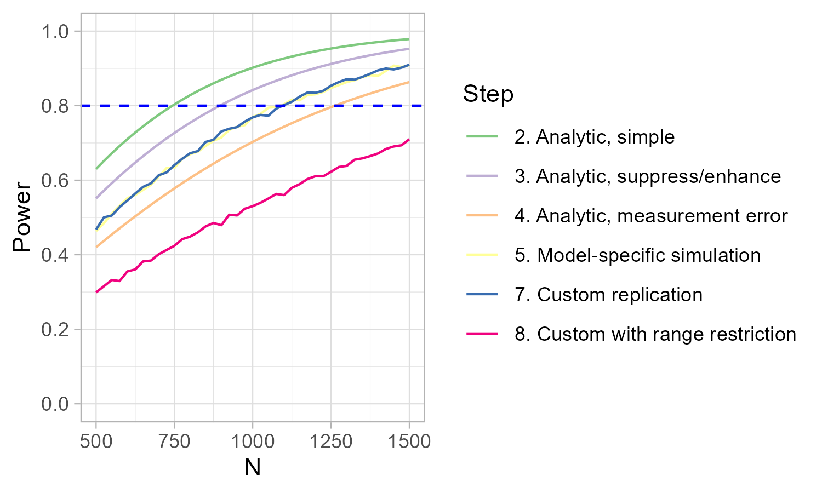
Example: Power Analysis of Regression Interactions

Slide 26
Simpr Philosophy
Custom functions not required
Minimize overhead code
Get people simulating as fast as possible!
statisfactions.github.com/simpr

Slide 27
Advanced Features of Simpr
More sophisticated specifications
Data munging capabilities
Sensibly handle errors
Reproducible workflows
Easy-to-use parallel processing
statisfactions.github.com/simpr

Slide 28
Data Munging Capabilities
range_sim = specify(pre = ~ rnorm(n, 0, sd), post = ~ pre + rnorm(n, mean_diff, sd)) %>% ## Define parameters and vary them define(n = c(100, 150, 200), mean_diff = c(10, 20, 30), sd = c(50, 100)) %>% ## Generate datasets generate(1000, .progress = TRUE) %>% ## Apply tidyverse functions to every simulation dataset per_sim() %>% ## Mutate to add a range restriction mutate(across(everything(), case_when( pre > 100 ~ 100, pre < -100 ~ -100, .default ~ pre))) %>% ## Fit datasets fit(t = ~t.test(post, pre, paired = TRUE)) %>% ## Collect results tidy_fits()
statisfactions.github.com/simpr

Slide 29
Error Handling
Can change error handling to keep going with simulation, stop simulation, or to skip warnings
Debug and recovery options to enter into simulation during error
statisfactions.github.com/simpr

Slide 30
Reproducible Workflows
Same seed, same results
Can regenerate just a specific subset to see what happened in that particular dataset or fit
Useful in debugging and diagnosing unexpected results, etc.
statisfactions.github.com/simpr

Slide 31
Reproducible workflows
Filtering Full Simulation
Simulate Subset Only
set.seed(500) specify(a = ~ runif(6)) %>% generate(3) %>% filter(.sim_id == 3)
## full tibble ## -------------------------- ## # A tibble: 1 × 3 ## .sim_id rep sim ## <int> <int> <list> ## 1 3 3 <tibble [6 × 1]> ## ## sim[[1]] ## -------------------------- ## # A tibble: 6 × 1 ## a ## <dbl> ## 1 0.371 ## 2 0.959 ## 3 0.633 ## 4 0.177 ## 5 0.803 ## 6 0.133
set.seed(500) specify(a = ~ runif(6)) %>% generate(3, .sim_id == 3)
## full tibble ## -------------------------- ## # A tibble: 1 × 3 ## .sim_id rep sim ## <int> <int> <list> ## 1 3 3 <tibble [6 × 1]> ## ## sim[[1]] ## -------------------------- ## # A tibble: 6 × 1 ## a ## <dbl> ## 1 0.371 ## 2 0.959 ## 3 0.633 ## 4 0.177 ## 5 0.803 ## 6 0.133
statisfactions.github.com/simpr

Slide 32
Parallel Processing
library(simpr) library(tidyverse) library(future) plan(multisession, workers = 6) # or however many cores are reasonable to use ## Specify pre and post scores that differ by a given amount sim_vary = specify(pre = ~ rnorm(n, 0, sd), post = ~ pre + rnorm(n, mean_diff, sd)) %>% ## Define parameters and vary them define(n = c(100, 150, 200), mean_diff = c(10, 20, 30), sd = c(50, 100)) %>% ## Fit datasets fit(t = ~t.test(post, pre, paired = TRUE)) %>% ## Collect results tidy_fits() %>% ## Generate datasets (and perform post-processing) generate(1000, .progress = TRUE)
statisfactions.github.com/simpr

Slide 33
Pros and Cons of simpr vs. other solutions
tidyverse friendly
Beginner friendly
Reproducibility, error handling built in
General-purpose, customizable and can handle arbitrary R code
Likely not as fast/optimized as some alternatives
Not as customizable/powerful as DeclareDesign
Not specifically set up for any particular application (no MC errors, plots, reports, specific models…)
statisfactions.github.com/simpr

Slide 34
Future Directions
“Chunking”/options for autosaving intermediate results to disk
Model-specific support for common design analyses (use DesignLibrary?)
Test coverage! 🐜🐜🐜
statisfactions.github.com/simpr

Slide 35
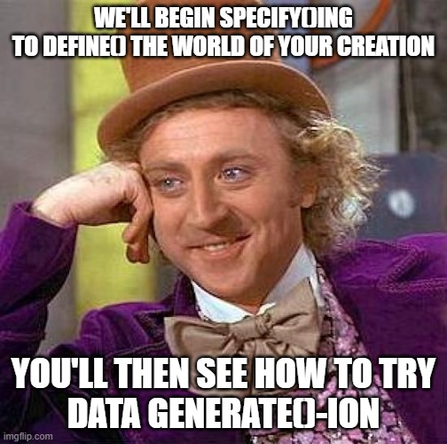
specify()
define()
generate()

Slide 36
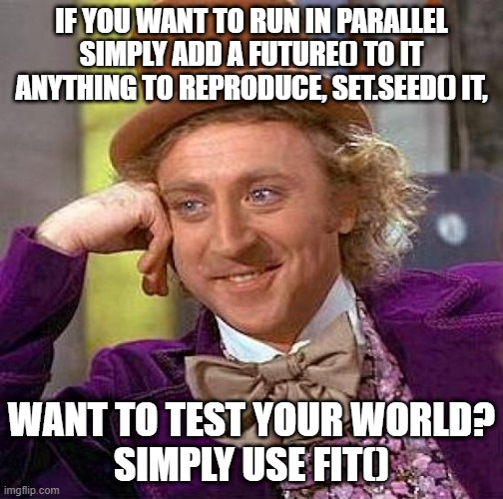
library(simpr) library(tidyverse) library(future) plan(multisession, workers = 6) # or however many cores are reasonable to use
set.seed(500) specify(a = ~ runif(6)) %>% generate(3, .sim_id == 3)
fit()
tidy_fits()

Slide 37

There is no way, I know To compare with simpr simulation Coding there, you'll be free If you truly wish to be

Slide 38
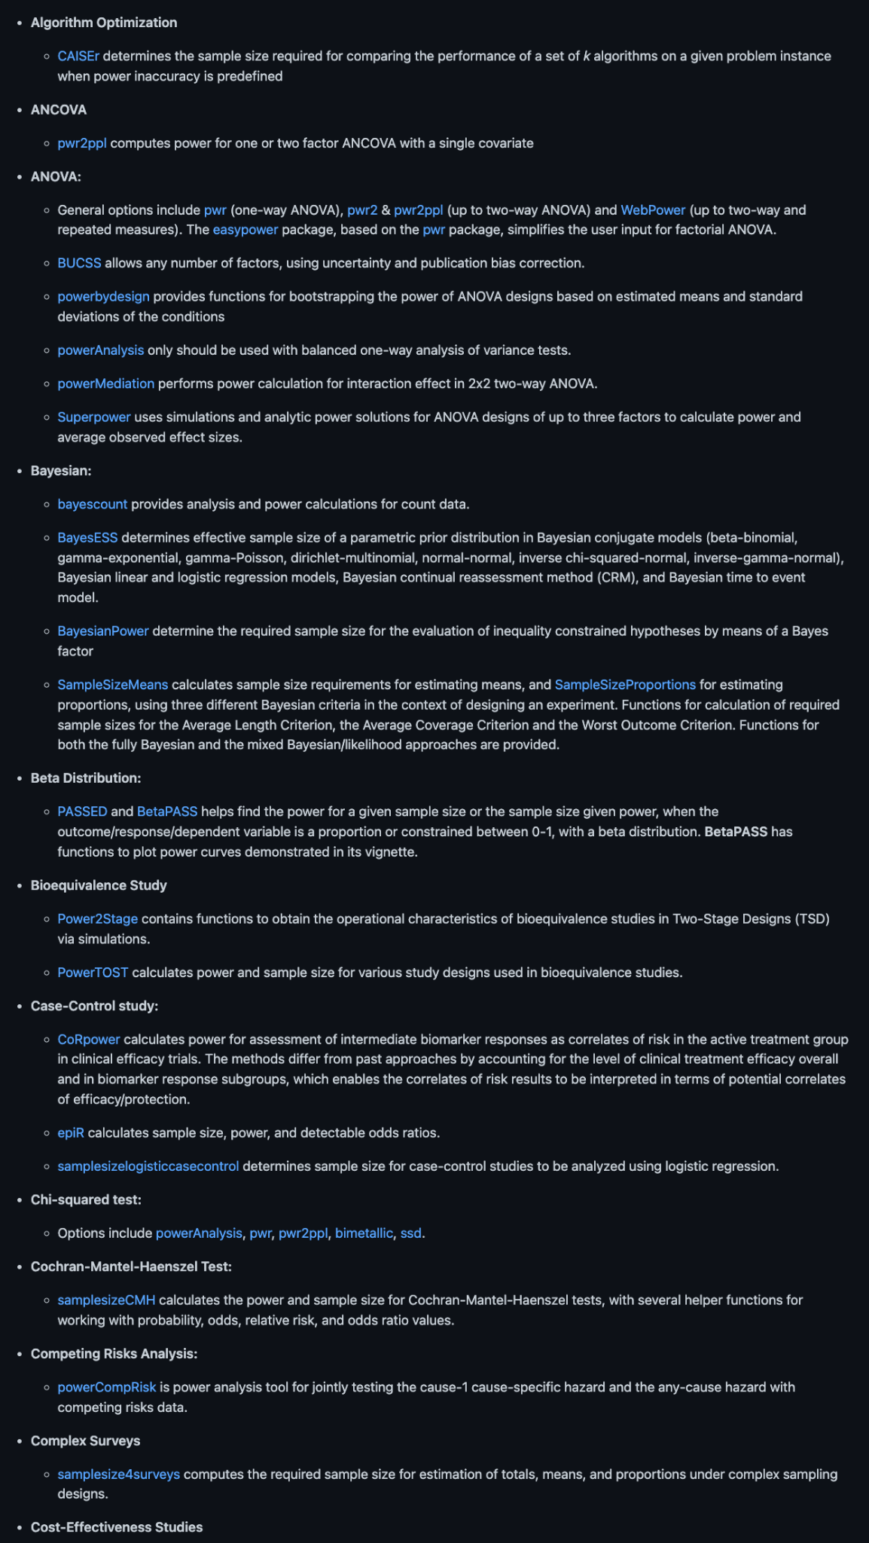
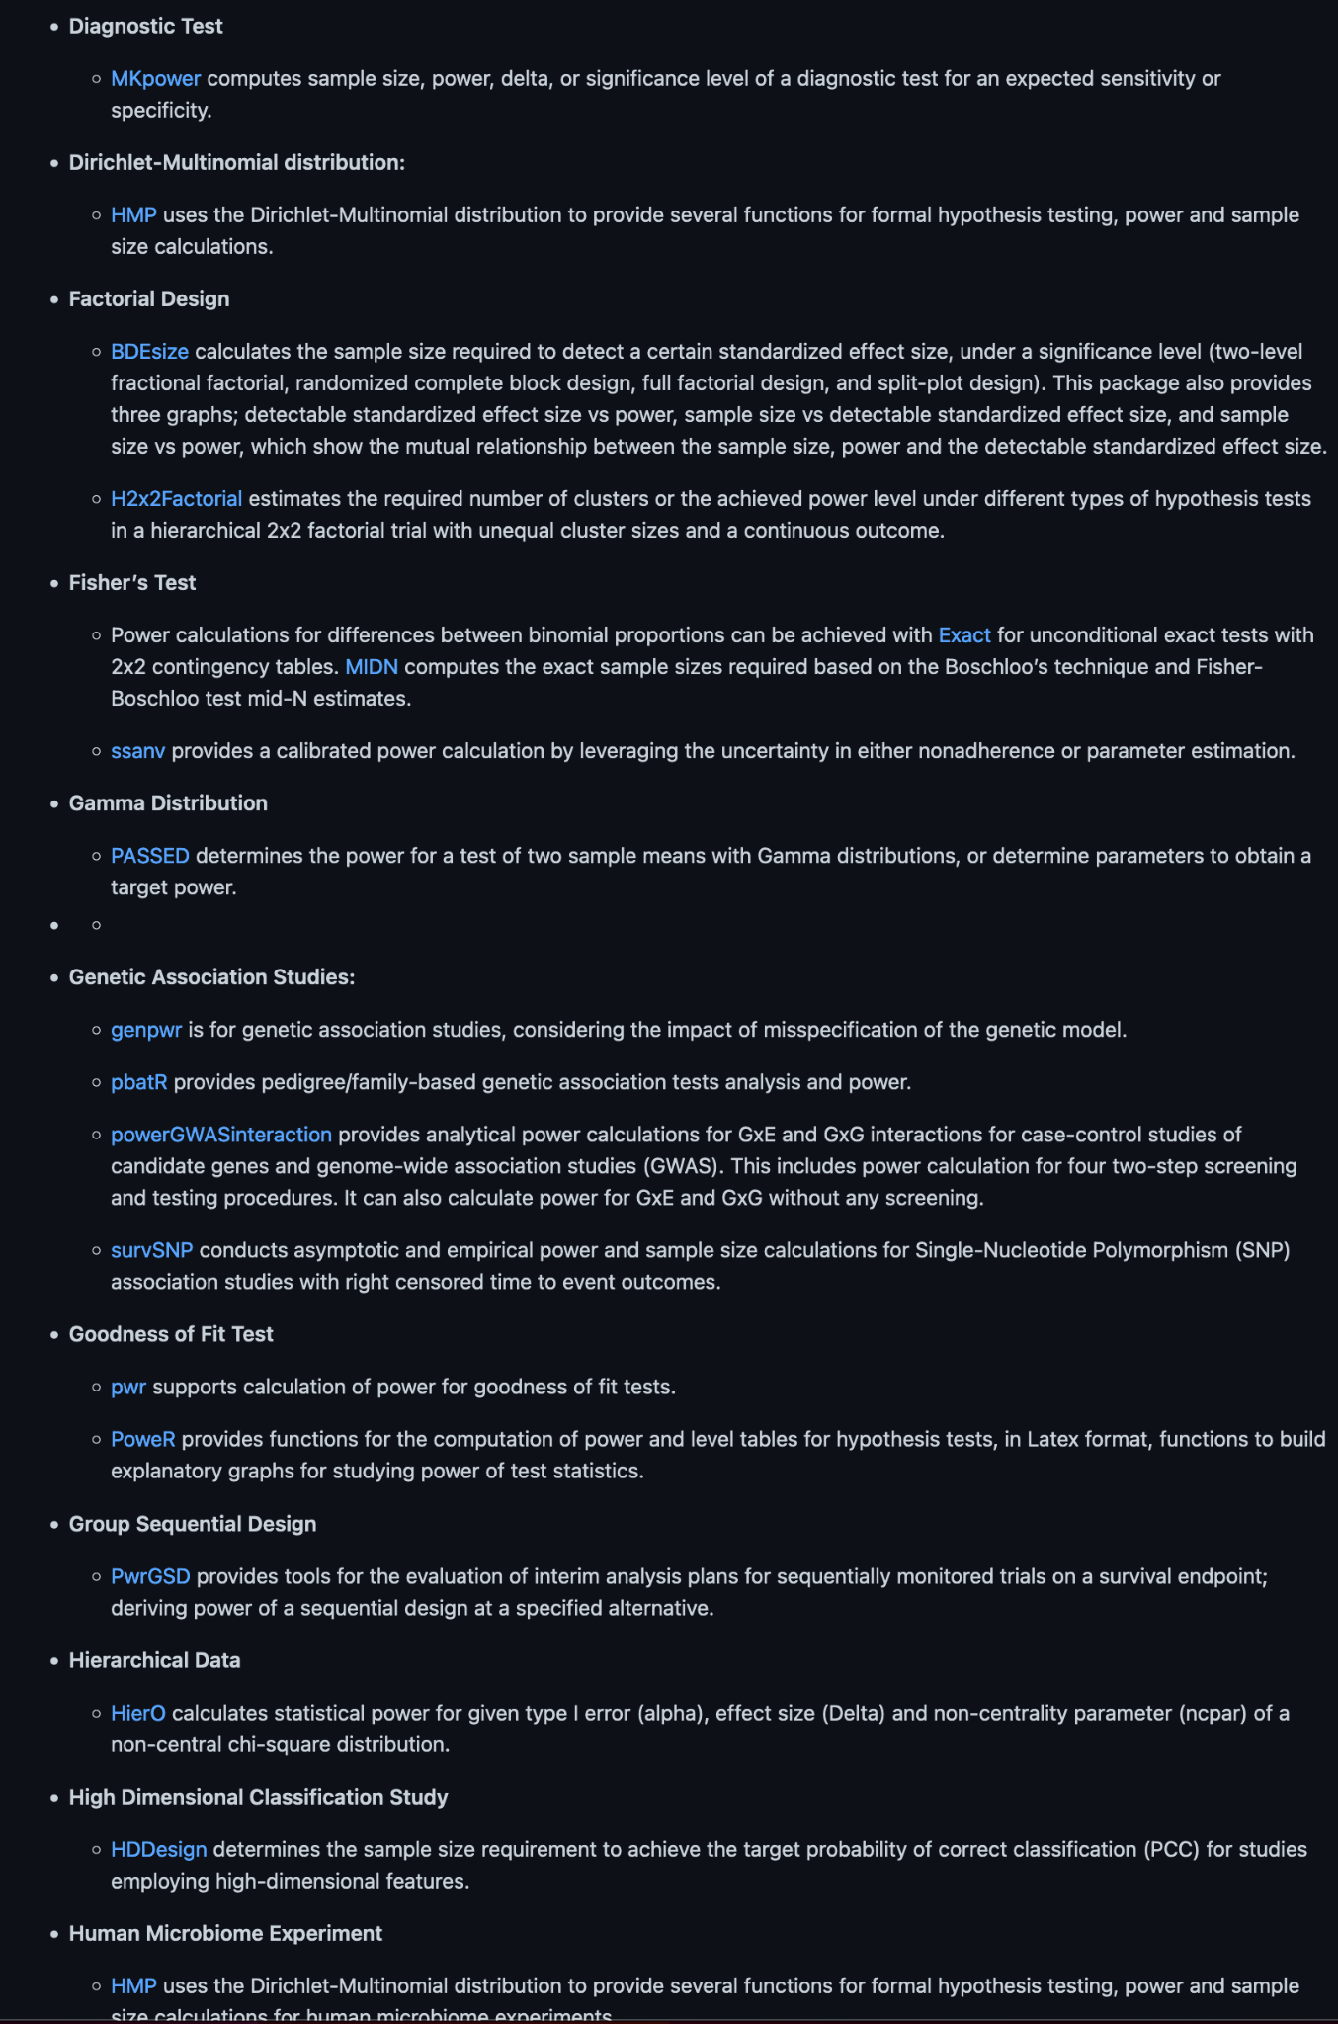
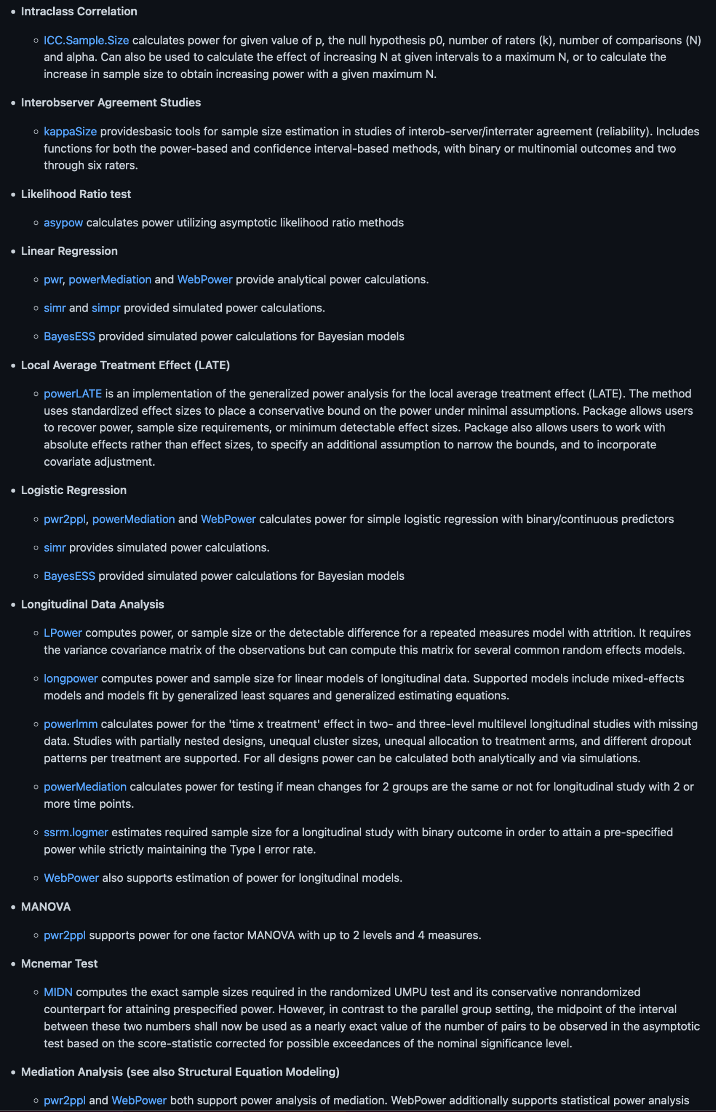
Relatedly: Message me if you’re interested in helping with a Power Analysis Task view! 🥺🥺🥺🥺🥺
Github/X: @statisfactions
https://github.com/statisfactions/ctv-power

Slide 39
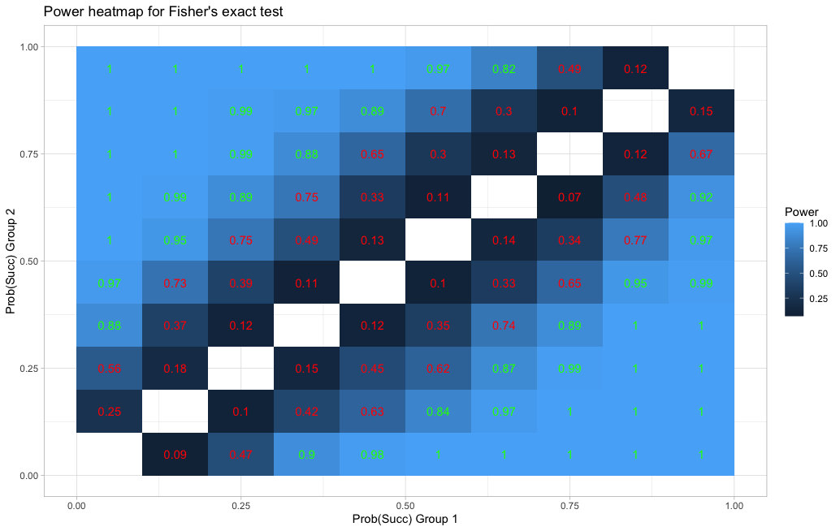
Study planning: Power for a Fisher exact test
(Mazzocco et al., 2020)
statisfactions.github.com/simpr

Slide 40
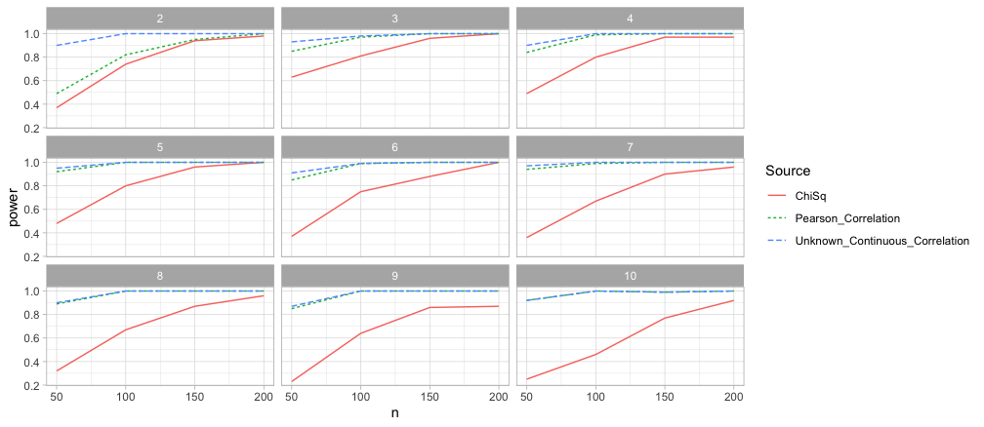
Methodological research: Effect of the number of Categories on Power
statisfactions.github.com/simpr

Slide 41
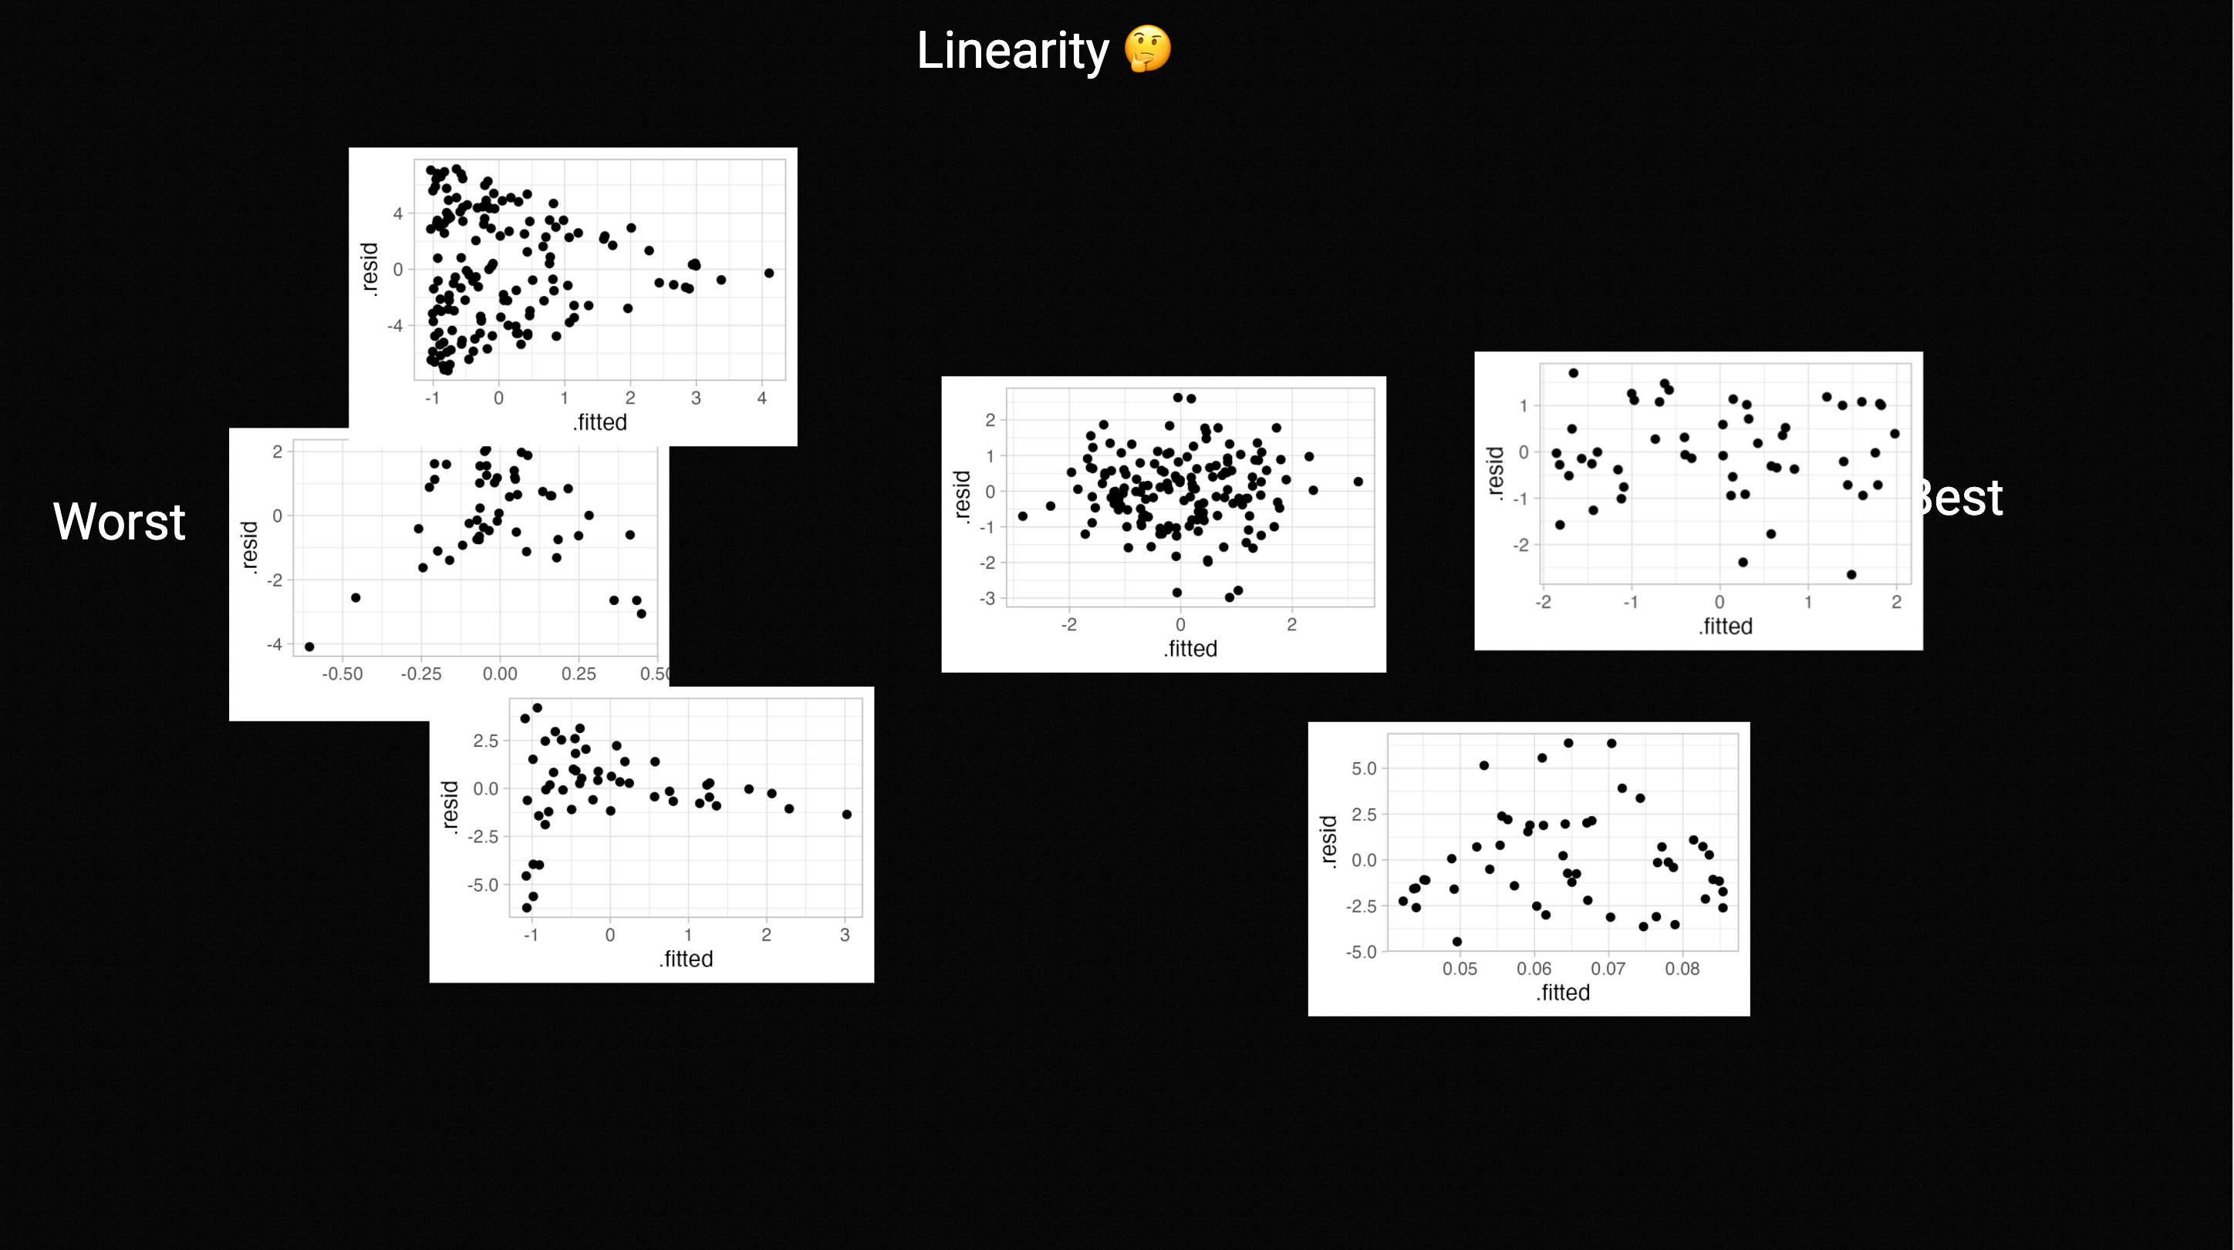
Generating examples for Teaching: Regression Assumptions
statisfactions.github.com/simpr

